Slide 1



BMS College of engineering
Department of CSE
AUTHENTICATION DAPP
PRESENTED BY
UNDER THE GUIDANCE OF
Jyothika C N(1BM21CS083)
Palle Padmavathi(1BM21CS125)
Namratha M
Assistant Professor
Department of CSE

Slide 2
1
Introduction
2
Blockchain platform
3
Work highlights
4
Relevance
5
Implementation details

Slide 3
Introduction
In today's digital age, secure authentication is paramount, and traditional systems often fall short. By leveraging Ethereum's decentralized platform, we have developed a robust authentication system as a decentralized application (dApp). This project utilizes blockchain's security, transparency, and immutability to enhance user authentication processes. We'll cover the blockchain platform choice, work highlights, the relevance of blockchain for this application, detailed implementation steps, and a live demo.

Slide 4
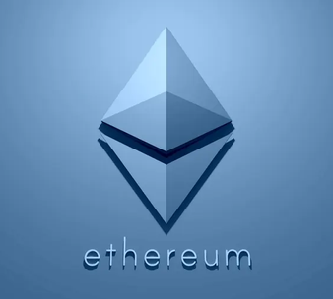
Blockchain platform -Ethereum
The blockchain platform chosen for our project is Ethereum, renowned for
Its decentralized architecture
Robust capabilities in facilitating smart contracts
Decentralized applications (dApps).
Ethereum's decentralized nature ensures heightened security, as there's no single point of control vulnerable to breaches. This aspect is particularly crucial for authentication systems where data integrity is paramount. Moreover, Ethereum boasts an active and vibrant developer community, offering a plethora of resources and tools that streamline the development process.

Slide 5
Reasons for Choosing Ethereum
Active Developer Community: Ethereum boasts a vibrant and active developer community, offering extensive resources, tools, and support, which streamline the development process and ensure a smoother implementation of our authentication system.
Decentralized Architecture: Ethereum's decentralized nature aligns perfectly with the security requirements of authentication systems, mitigating risks associated with single points of failure and enhancing overall system security.
Support for Smart Contracts: Ethereum's support for smart contracts enables us to implement complex authentication logic in a transparent and immutable manner, ensuring the integrity and trustworthiness of the authentication process.
Web3 Support and Wallet Integration: Ethereum's compatibility with the Web3 JavaScript API allows seamless integration with web applications, enabling interaction with the Ethereum blockchain directly from the browser.

Slide 6
Blockchain is highly relevant for the chosen application due to several key factors:
Security: By storing user credentials on the blockchain, the application ensures that authentication processes are resistant to tampering, unauthorized access, and data breaches.
Transparency: Each authentication event, such as user registration or login, is recorded on the blockchain in a tamper-proof manner.
Decentralization: Authentication data is distributed across a network of nodes, reducing the risk of single points of failure and enhancing the overall resilience of the authentication system.
User Control: Users can manage their authentication data directly through their blockchain wallets, enhancing privacy and reducing the risk of unauthorized access.
Immutable Record-Keeping: Blockchain ensures that once authentication data is recorded on the blockchain, it cannot be altered or deleted.

Slide 7
Tools used
Solidity: Solidity is a high-level programming language used for writing smart contracts on the Ethereum blockchain.
MetaMask: MetaMask is a browser extension that serves as a digital wallet and gateway to the Ethereum blockchain.
Truffle Framework: Truffle is a development framework for Ethereum that provides tools for writing, testing, and deploying smart contracts.
Ganache: Ganache is a personal Ethereum blockchain that can be used for local development and testing of smart contracts.
Web3.js: Web3.js is a JavaScript library that allows interaction with Ethereum smart contracts and the Ethereum blockchain. It provides a set of APIs for connecting to Ethereum nodes, deploying contracts, and invoking contract functions from web applications.

Slide 8
Smart contracts
Auth Smart Contract:
User Registration
Data Storage
Event Emission: An userCreated event is emitted whenever a new user account is successfully created.
Migrations Smart Contract:
Migration Management: Manages the migration process of other smart contracts within the Truffle framework.
Ownership Control: Ensures that critical migration operations are performed by authorized parties.

Slide 9
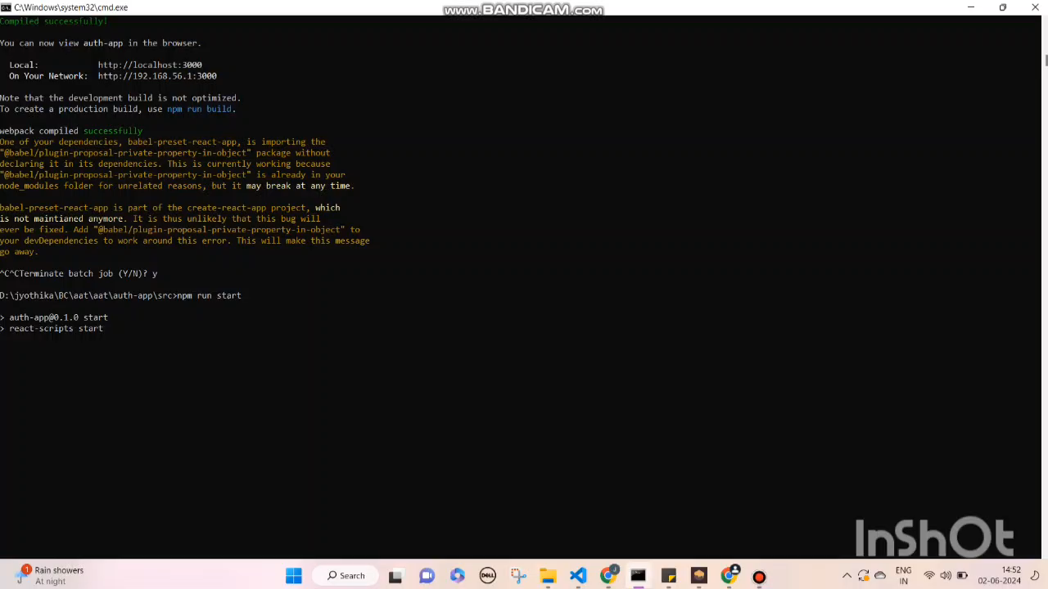
Demonstration

Slide 10
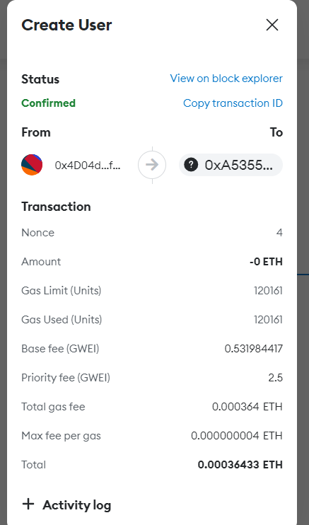
User created transaction in metamask

Slide 11
References
Guideline for using ganache: https://cointelegraph.com/news/how-to-use-ganache-for-blockchain-project-development
Web3 : https://web3.career/learn-web3/web3-tutorial-node-js
Solidity: https://www.geeksforgeeks.org/solidity-basics-of-contracts/
Github repository link:

Slide 12
Thank you

